Slide 1


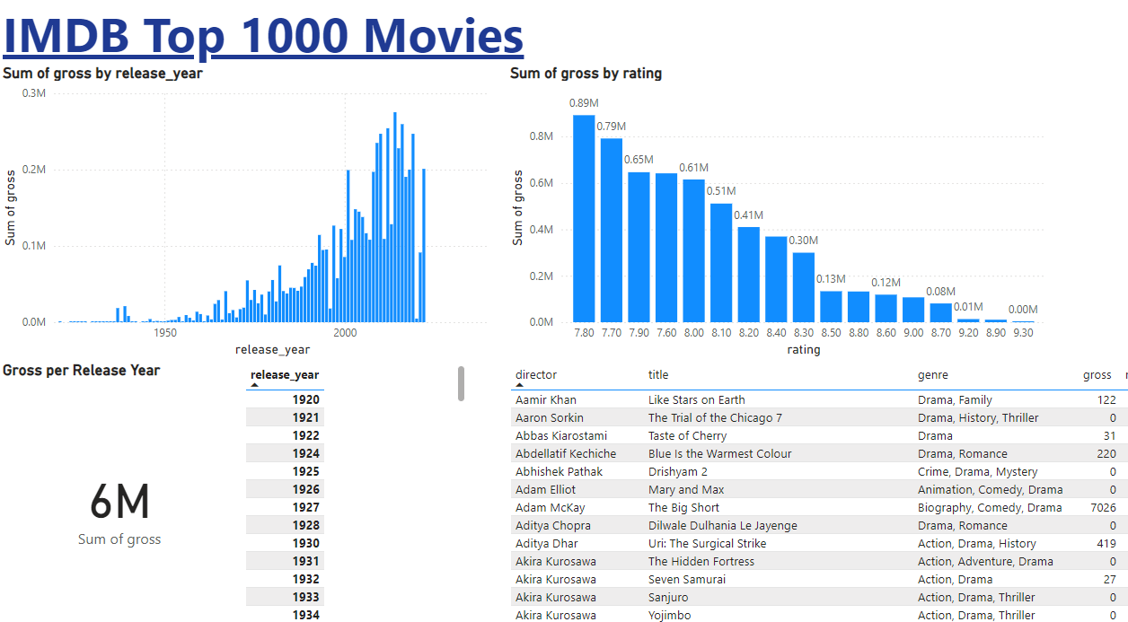



IMDB Top 1000 Movies
Movie Average Runtime
120 min
Business Context
The entertainment industry faces challenges in identifying the key drivers of a movie's financial and critical success. With limited data-driven insights, production companies, streaming platforms, and marketing teams often make decisions based on intuition rather than evidence. Understanding the factors influencing a movie's success—measured by audience ratings, critics' scores, and gross revenue—is critical to improving decision-making.
Movie Average Ratings
7.9
Movie Average Metascore
66.6
Movie Average Gross
5775
Analysis
Conclusion
In an exploration of the top 100 movies on IMDB, an analyst sought to uncover the factors driving box office success. The dataset revealed that while most movies were recent and had high metascores, revenue (gross) varied widely, with some films earning Thousands and others much less. Surprisingly, newer movies tended to earn less, and longer runtimes or higher ratings didn’t always guarantee higher revenue. Critically acclaimed films, despite strong ratings and metascores, didn’t consistently perform well commercially. Action movies emerged as the most profitable genre, while Drama and Comedy films lagged behind. The analysis suggested that studios should focus on action films, maintain moderate runtimes, and use targeted marketing to bridge the gap between critical acclaim and commercial success.
This exploratory data analysis of the top 100 IMDB movies reveals key insights into box office success. Action films dominate in profitability, while Drama and Comedy films tend to earn less. Surprisingly, newer movies, longer runtimes, and higher ratings or metascores don't always correlate with higher revenue, indicating a disconnect between critical acclaim and commercial success. The analysis suggests that studios should focus on action films, maintain runtimes around 120 minutes, and use targeted marketing strategies to bridge the gap between critical and commercial performance. Further exploration of external factors like marketing budgets and audience demographics could provide deeper insights.
Gross vs Rating
As we can see, most viewers refer to movie ratings when deciding which film to watch. However, other factors such as genre preferences, ticket pricing, and marketing strategies also play a crucial role in a movie's commercial success. This indicates that while high-rated movies may be critically acclaimed, they are not always the most profitable. Many blockbuster films with moderate ratings tend to generate higher revenues due to wider audience appeal, aggressive promotions, and strategic release timings. Additionally, niche films with exceptional ratings might attract a smaller but more dedicated audience, which may not always translate into high box office earnings
Release Year vs Gross
We can see that as the years increase, the gross revenue of movies also increases. This suggests that, with the development of the movie industry and advancements in filmmaking technologies (such as CGI, high-definition cinematography, and immersive sound systems), movies have become more visually appealing and engaging for audiences. Additionally, the rise of global distribution channels, streaming services, and digital marketing has expanded the reach of films, leading to higher box office revenues. Inflation also plays a role, as ticket prices have risen over the years, contributing to the increasing gross earnings of movies.

